Slide 1
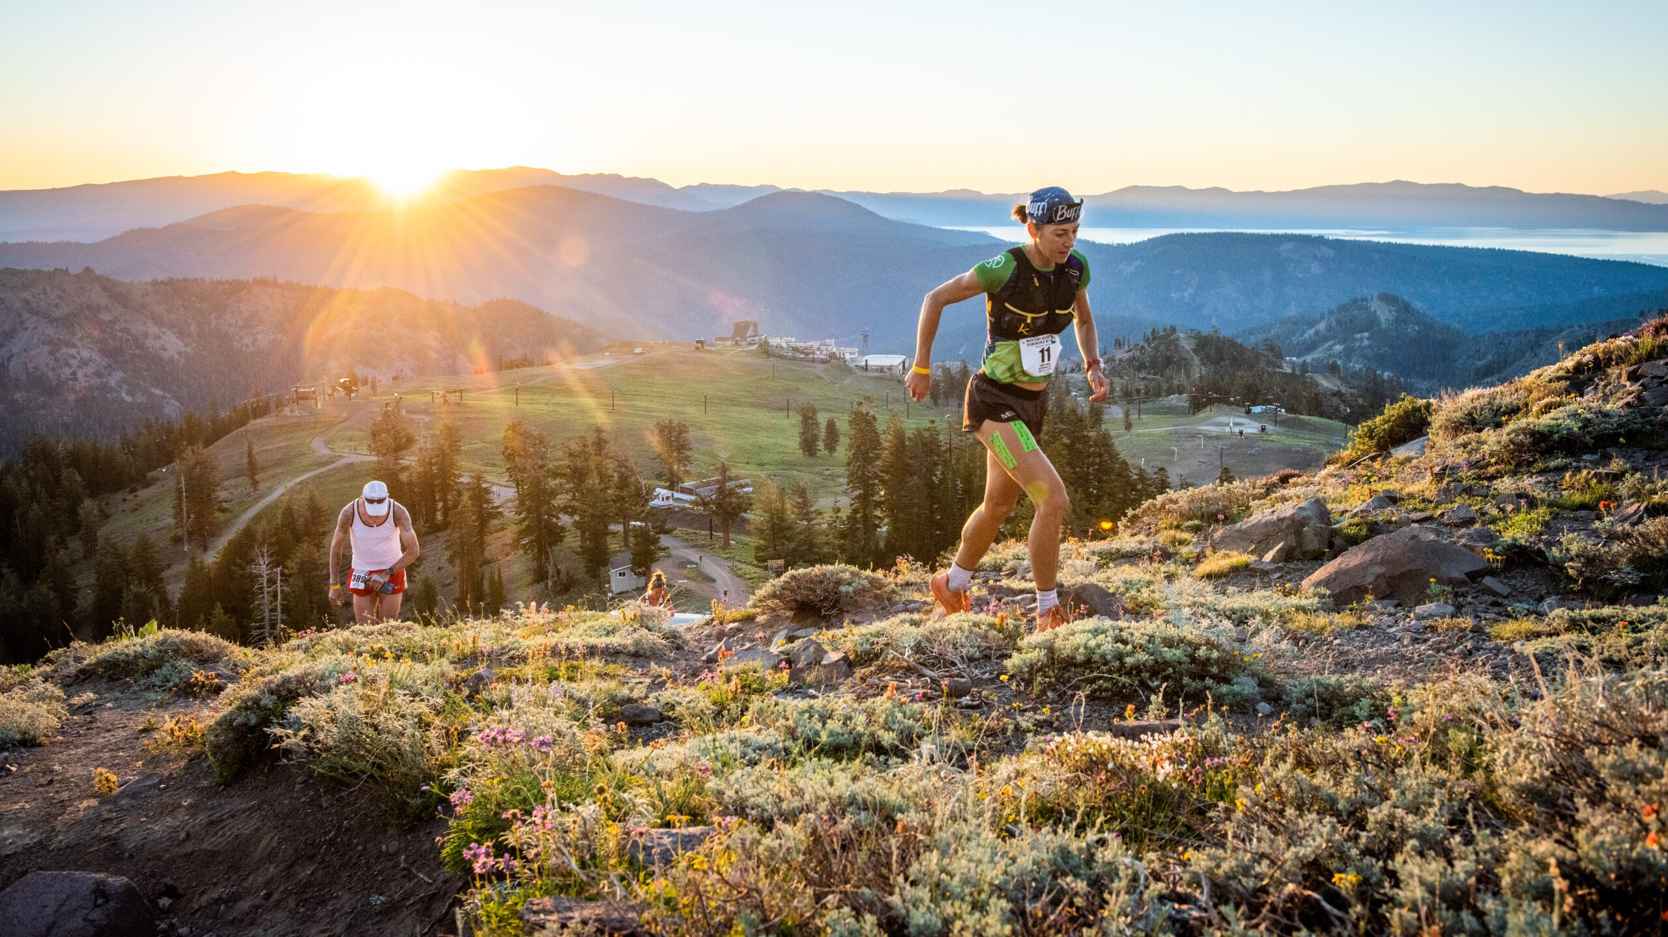
Chasing Golden Tickets: Trends and Insights from Western States
Presented by:
Chris Swann
Notes:
My name is Chris Swann. In this project, Chasing Golden Tickets: Trends and Insights from Western States, I analyze performance patterns among elite ultramarathon athletes by evaluating their results from Golden Ticket qualifying races in relation to subsequent outcomes at the Western States Endurance Run. Because ultra-endurance athletics is a personal passion of mine, I saw this an opportunity to merge that enthusiasm with a rigorous, data-driven approach to understanding the sport.

Slide 2
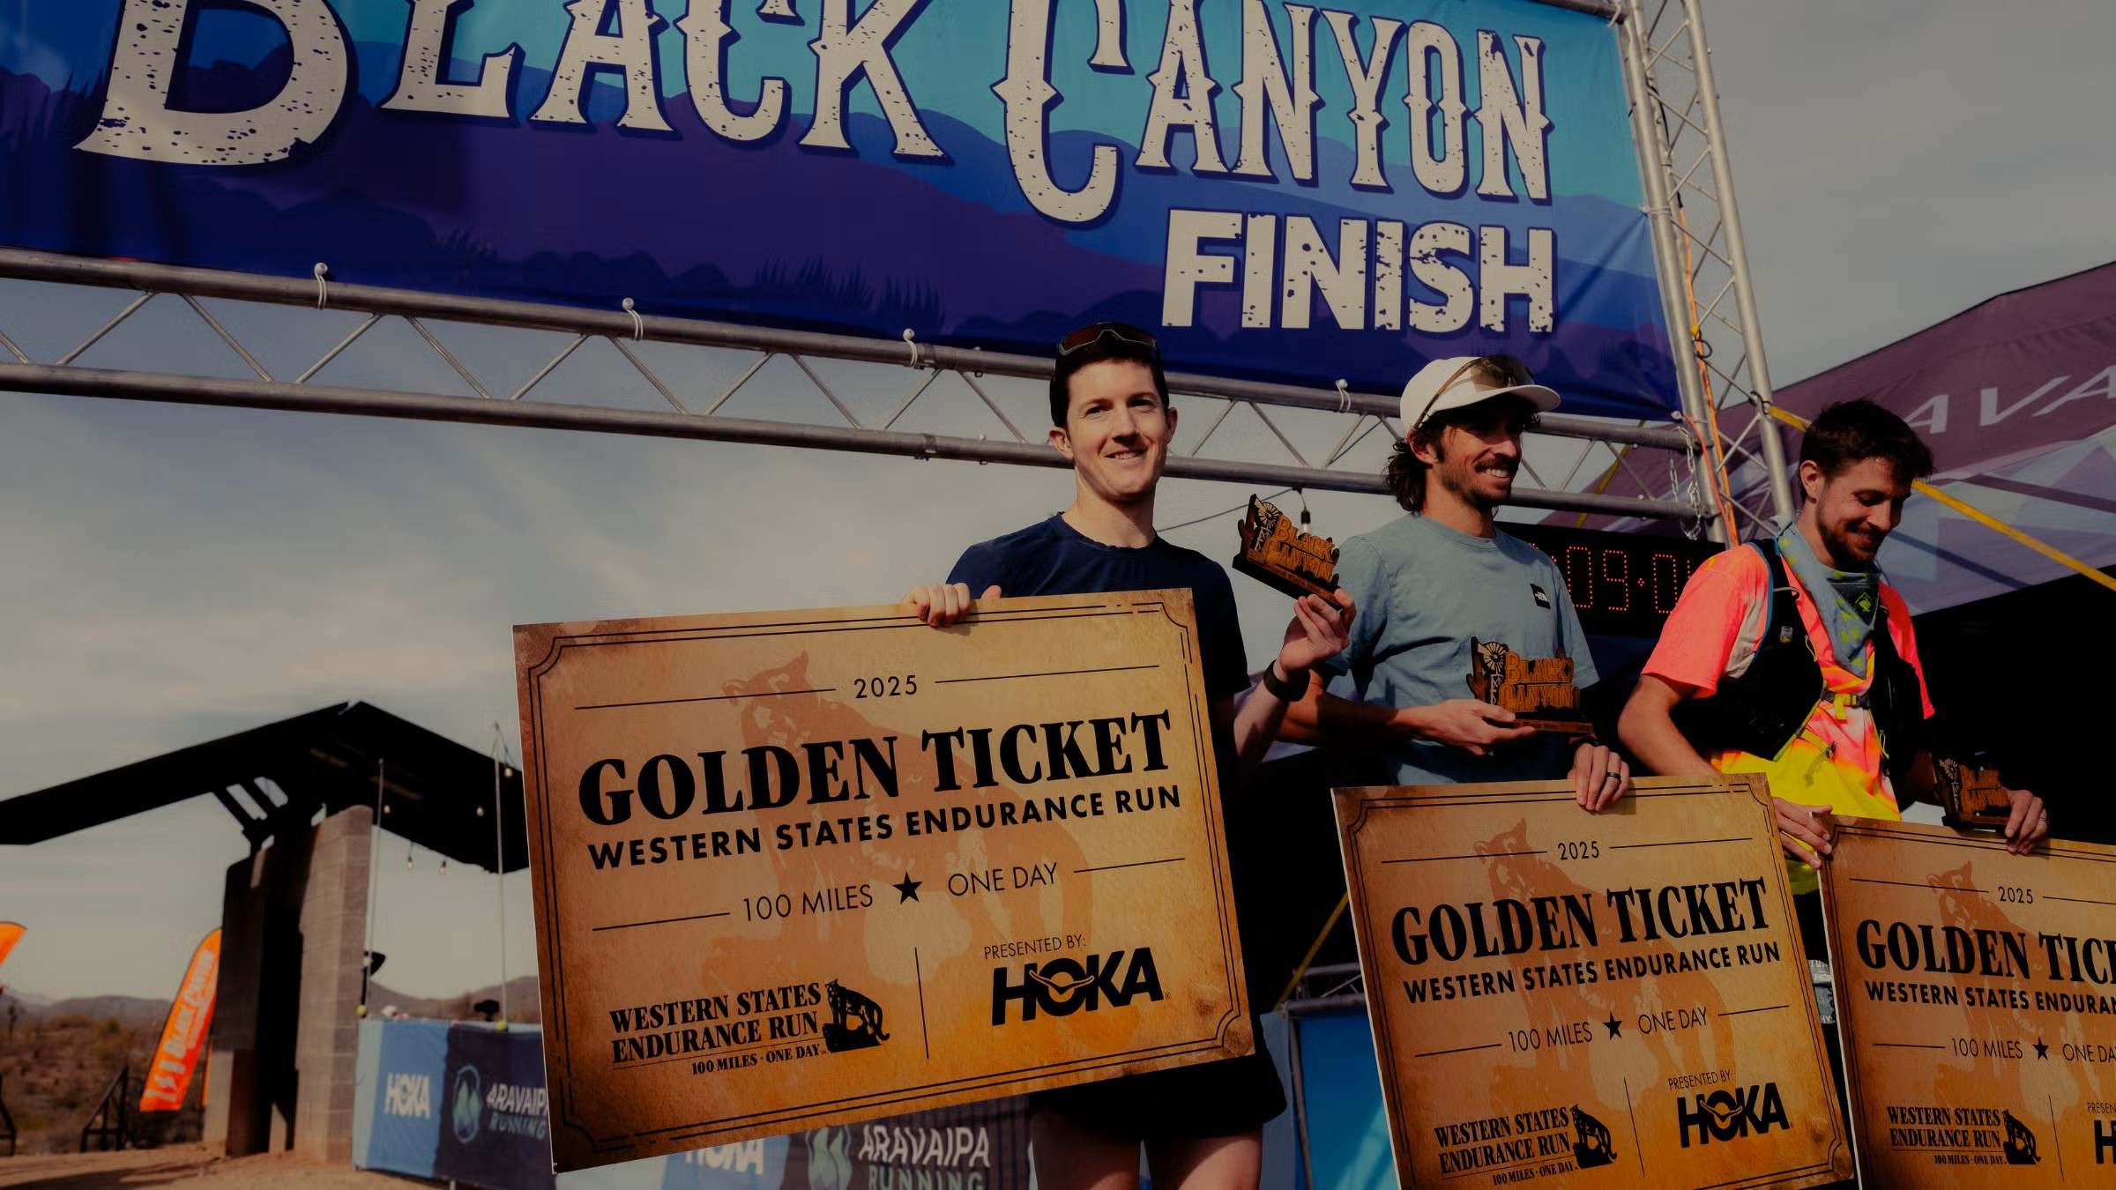





Data Acquisition: Metadata was programmatically extracted using Python from multiple sources, including Ultrasignup, UTMB, EDSResults, WesternStates. Course Metadata from GPX files.
Data Cleaning and Validation: Raw data underwent thorough cleaning to address inconsistencies, missing values, and formatting issues. Manual validation was performed in Excel to ensure data integrity and reliability.
Database Management: A PostgreSQL database was developed in pgadmin4 to store and query the cleaned datasets efficiently.
Analytical Framework: Data analysis was performed using the pandas library in Python, enabling robust manipulation and exploration of race metrics.
Visualization: Generated using Python packages matplotlib and seaborn, as well as Microsoft Power BI to illustrate key trends and insights.
Notes:
Race results for both Golden Ticket events and Western States were collected through Python web scraping from multiple respected ultrarunning sources. The raw data was cleaned, merged, and validated in Excel and Python before being structured into a PostgreSQL database in pgAdmin, allowing for efficient storage and SQL-based querying. Analysis and visualizations were built using Python and Power BI. I also want to give a special thank-you to a fellow acquaintance in the sport, Liam Lionsdale (aidstationfireball), for sharing his curated list of Golden Ticket recipients for 2020 – 2025 — data that is surprisingly difficult to find and often inaccurate online.

Slide 3

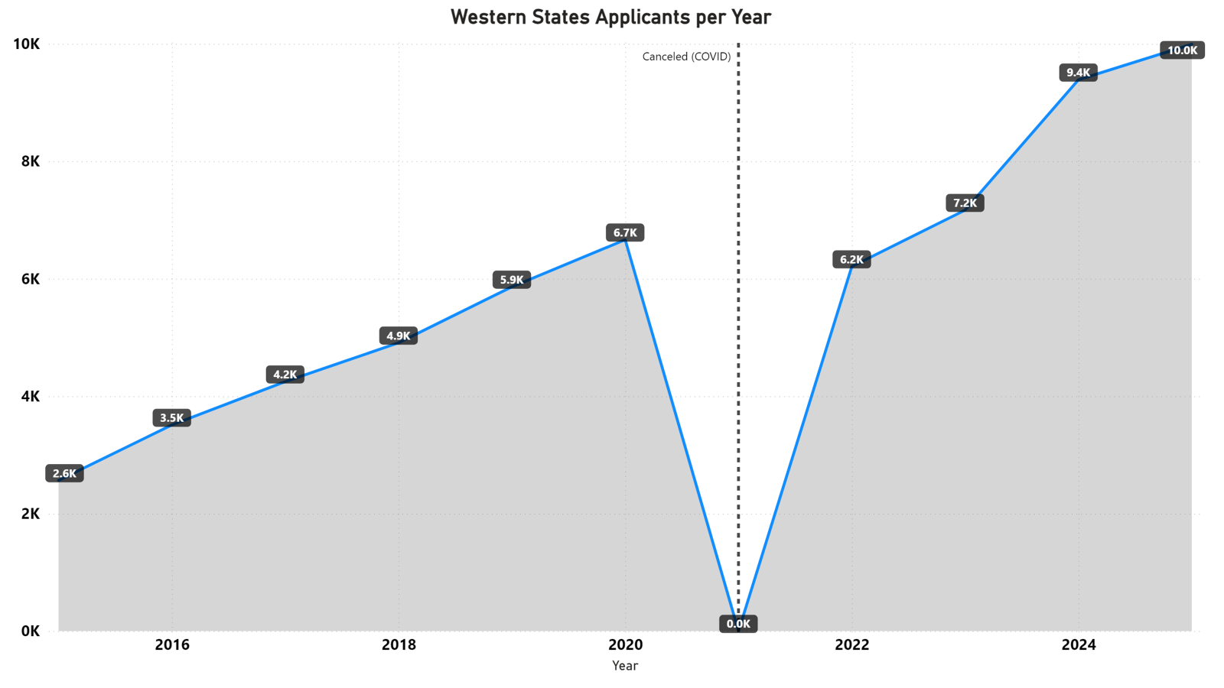
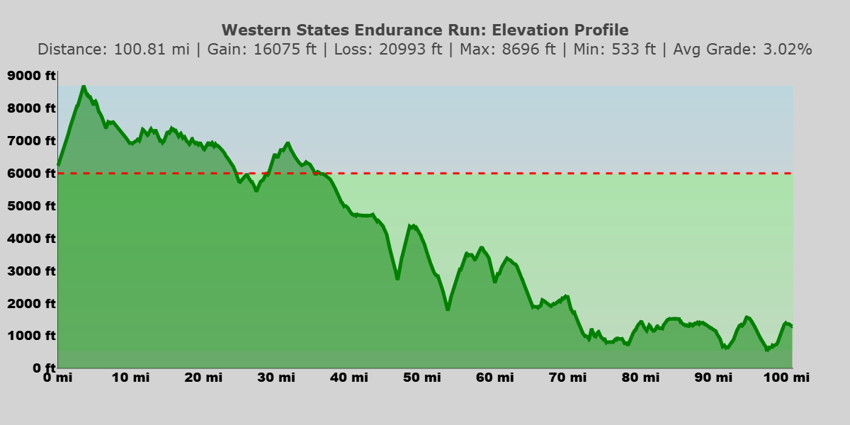
Western States Endurance Run Oldest 100-mile ultramarathon, widely regarded as the pinnacle of ultrarunning
Entry Process:
Lottery System: ~260 spots
Must complete a qualifying race each year to apply
Tickets increase exponentially for each subsequent year an applicant applies
2025: 68,724 lottery tickets , 0.4% chance to be selected
Golden Ticket Races: Top finishers at select events earn guaranteed entry
1st and 2nd male/female at GT races
Top 10 Automatic Re-Entry:
Previous year's Top 10 finishers receive invitation
Continuity in elite field
Limited Field: 369 Starters
Applications: 9,993 (2025)
- 20% YoY Increase
Olympic Valley, CA Auburn, CA
~30 miles > 6,000 ft
Canyon Temps: 95°F - 100°F (~30-40 mi)
Notes:
Western States is the oldest 100-mile ultramarathon in the world and is widely considered the pinnacle event in trail ultrarunning. One of the things that makes this race so competitive is how limited the field is. Only 369 runners are allowed to start each year, yet demand has skyrocketed.
In 2025, nearly 10,000 athletes applied—representing a 20% year-over-year increase in applicants since 2015. The main entry into the race is through a lottery system which allocates roughly 260 of those spots 369 spots. To even enter, athletes must complete a qualifying race each year, and their ticket count increases the longer they’ve been applying without getting selected. In 2025 there were over 68,000 total lottery tickets in the system, giving a first time applicant about a 0.4% chance of getting in.
Outside the lottery, there are two major pathways to entry that directly relate to my project: Golden Ticket races, where the top two male and female finishers earn guaranteed entry; and automatic re-entry, where the previous year’s Top 10 finishers receive an invitation back. These mechanisms are what maintain continuity among elite athletes from year to year.
The elevation profile on the bottom right highlights another defining feature of Western States—its terrain and environmental extremes. The race starts in Olympic Valley, CA around 6,000 feet, climbs immediately to nearly 9,000 feet, and then trends downhill toward Auburn, CA. Athletes face canyon temperatures ranging from 95 to over 100 degrees for nearly 30 to 40 miles. The combination of altitude, technical terrain, and extreme heat makes the race uniquely challenging, even by 100-mile standards.

Slide 4
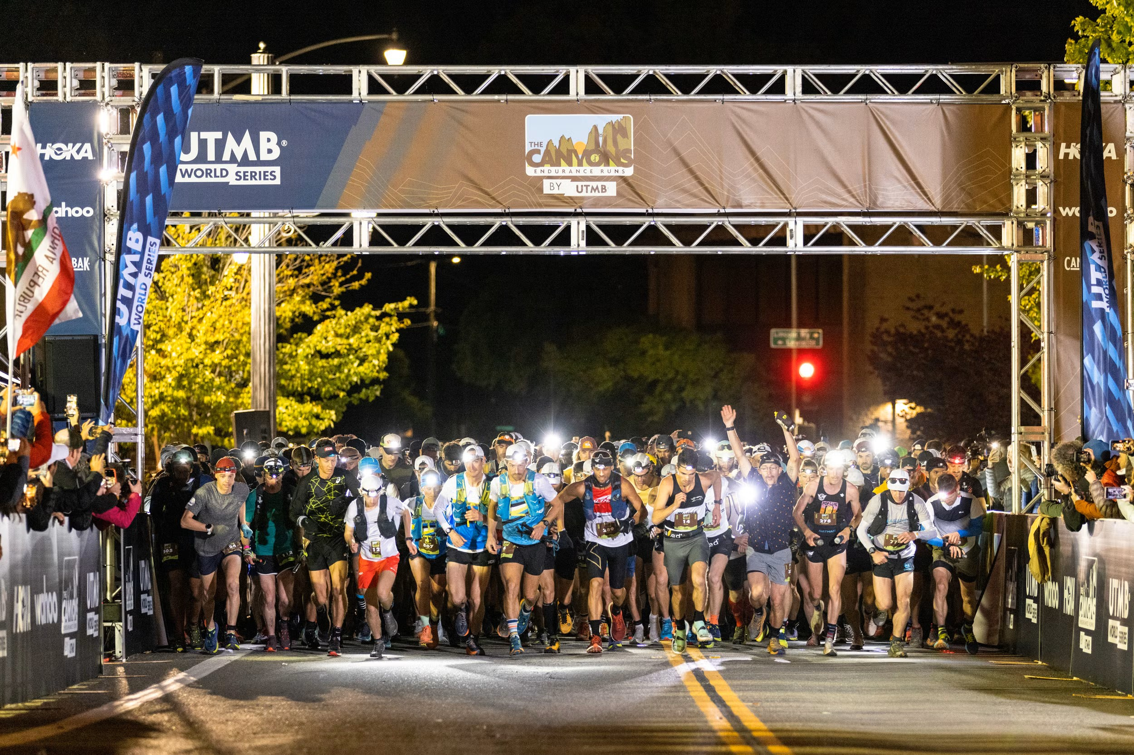
What are Golden Ticket Races and Why Do They Matter?
Western States:
Attracts elite fields, field diversity with international competition, and rising athletes trying to break into the professional side of the sport
Athlete:
Earning a ticket can change an up-and-coming athlete's career: sponsorships and media attention potentially translates into financial security
Notes:
Golden Ticket races are a select group of competitive ultras where the top two male and top two female finishers earn automatic entry into the Western States Endurance Run. These races are strategically chosen for their difficulty, depth of competition, and alignment with Western States qualifying standards.
Why They Matter
For Western States: Golden Ticket races ensure a deep, competitive, and internationally diverse elite field every year.
For Athletes: Winning a ticket can be career-changing — providing exposure, sponsorship opportunities, and a direct pathway into one of the most prestigious races in ultrarunning and a chance at making their mark in the sport.

Slide 5

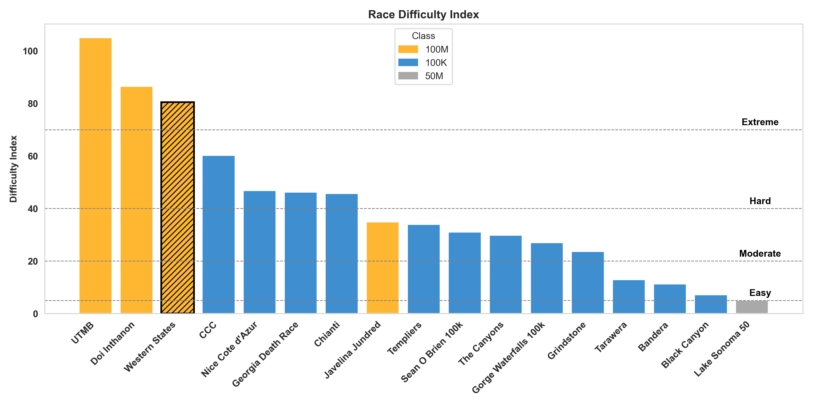


Golden Ticket Races
Unique GT Races: 16 | 2016-2025
5-7 per year
Distance Range: 50 - 108 miles
Elevation Gain: Highly variable
4,501ft (Black Canyon) to 32,155ft (UTMB)
Altitude Exposure ( >6000ft ): UTMB (37mi), Western States (31mi), CCC (24mi)
Notes:
The Western States Board selects Golden Ticket races each year. Many events return annually, but some have only been used once or twice depending on course quality, competitive depth, and scheduling.
Across the 2016–2025 period in this dataset, there are 16 unique Golden Ticket races — 9 domestic and 7 international. These races vary significantly in distance, ranging from 50 miles to 108 miles, and even more dramatically in elevation gain, descent, and total altitude exposure.
To quantify the differences between these events, I extracted course statistics from each race’s GPX file and used those inputs to calculate a Difficulty Index for every GT race. The bar chart on this slide highlights how those difficulty scores compare to Western States—shown with the striped bar—and categorizes each event into easy, moderate, hard, and extreme difficulty tiers.
A key takeaway here is that all but two Golden Ticket races are less difficult than Western States itself. It should also be noted that almost all of the races are 100K distance. One important note: weather plays a major role in actual race difficulty. Because conditions can change hour-by-hour and vary dramatically year to year, incorporating weather as a variable would require its own dedicated project. Although I explored collecting weather data via API, I ultimately excluded it from the Difficulty Index for this analysis. It remains an important future direction.

Slide 6
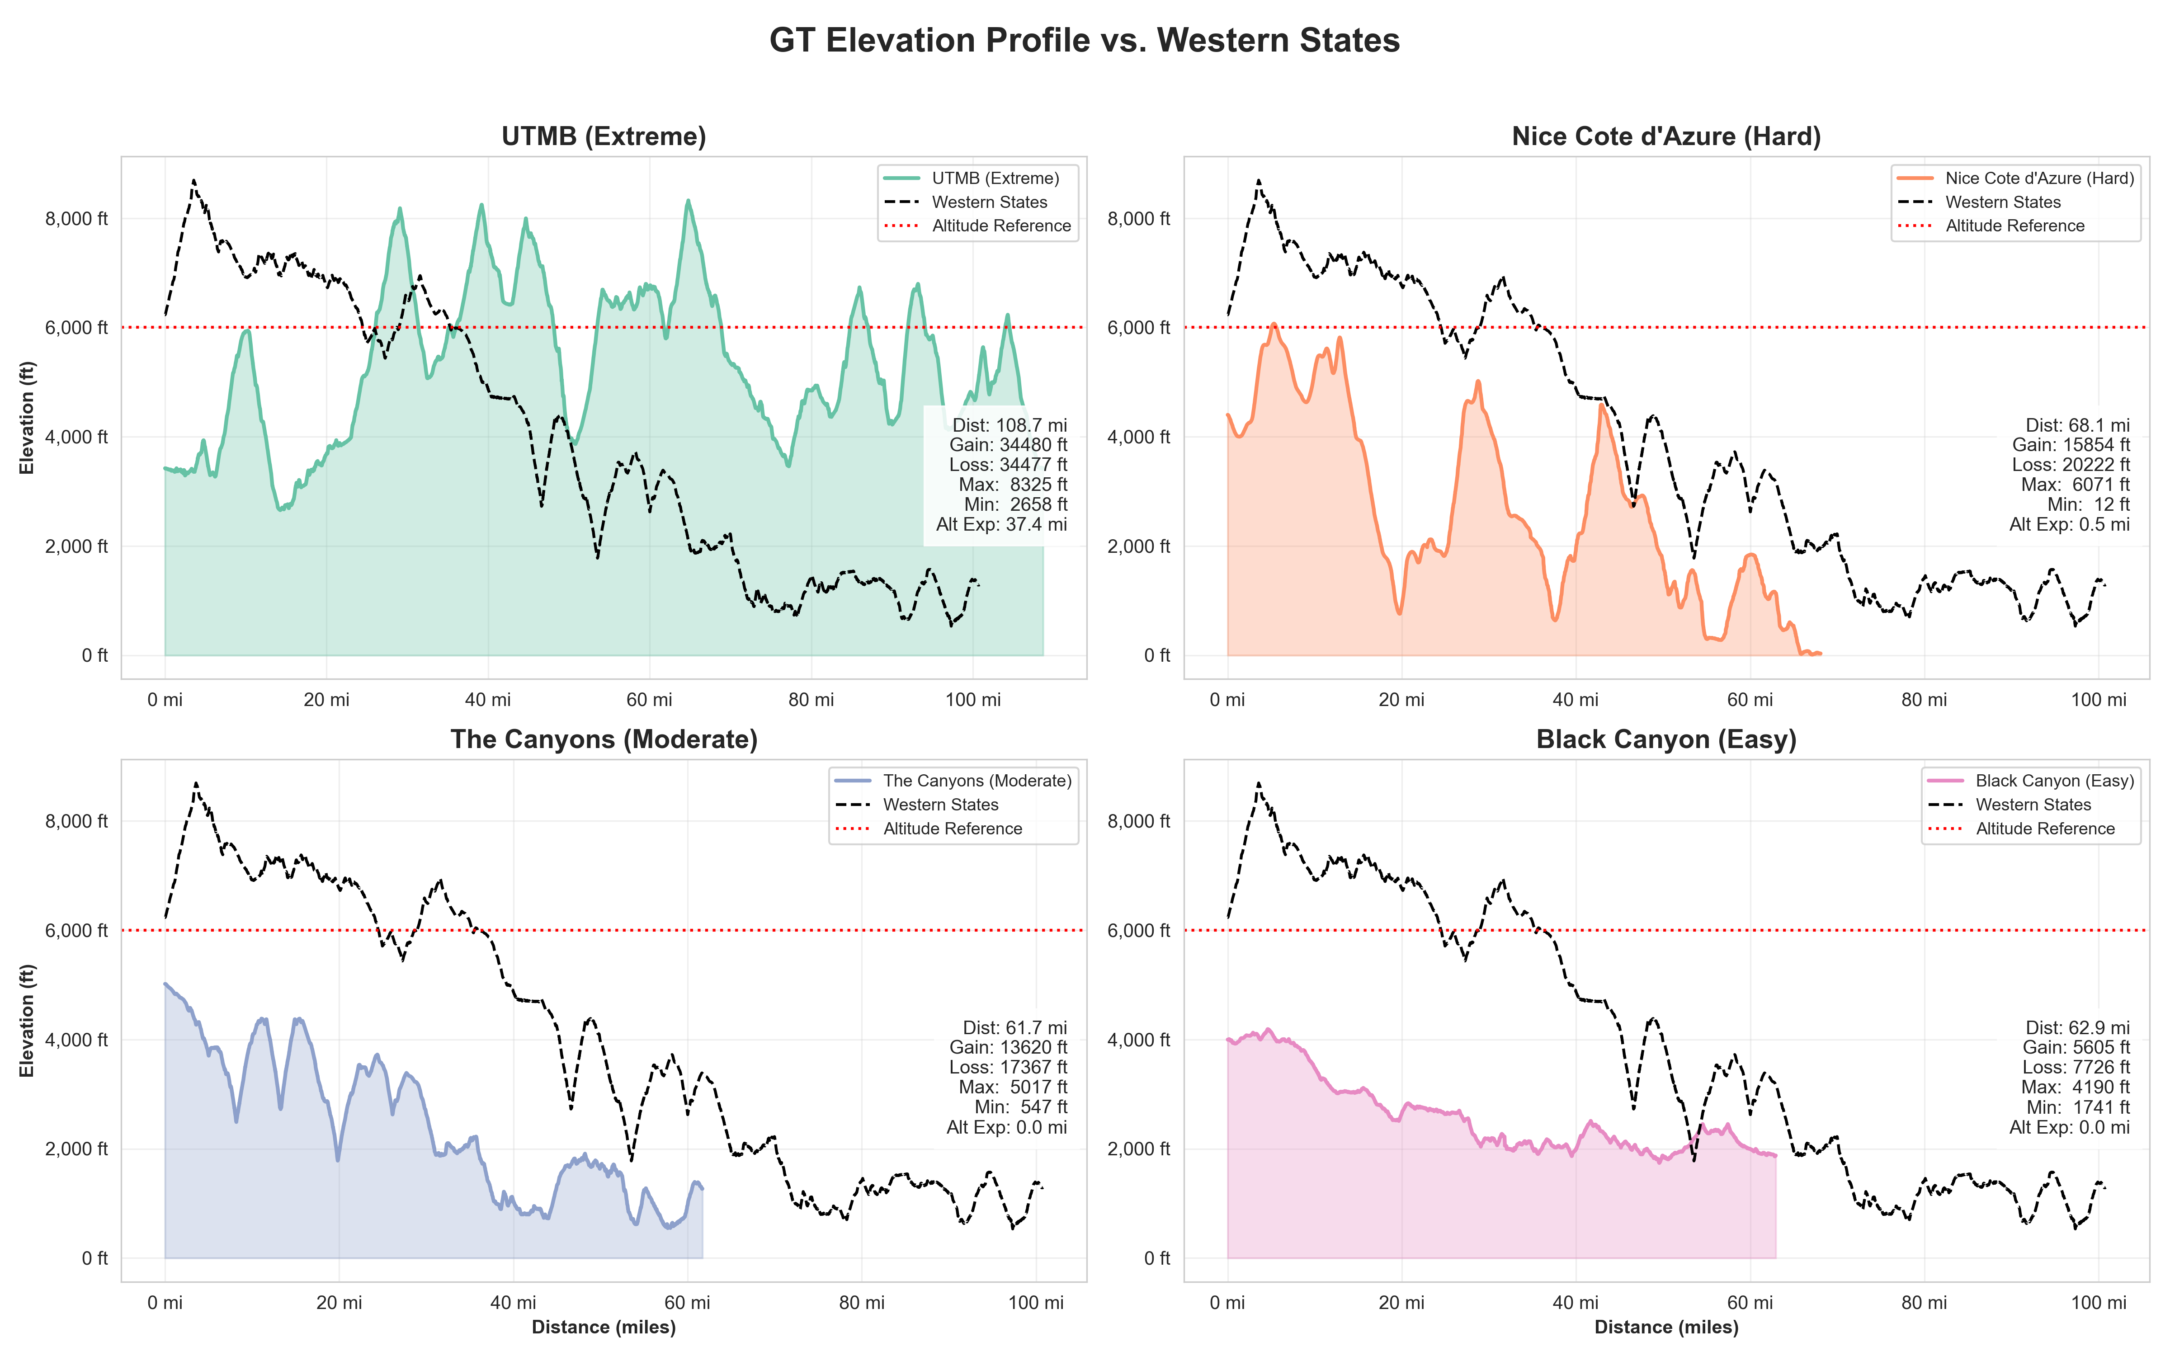
Western States
Reference
Dist: 100.8 mi
Gain: 16075 ft
Loss: 20993 ft
Max: 8696
Min: 533
Alt Exp: 31.8 mi
The Canyons is held on a portion of the Western States course
Notes:
This slide compares the elevation profiles of several Golden Ticket races—each from a different difficulty category—to the Western States course shown as the black dotted line. On the left, I included a reference panel summarizing key Western States metrics, including its 100.8-mile distance, 16,000 feet of climb, nearly 21,000 feet of descent, and over 30 miles of altitude exposure above 6,000 feet.
Starting with UTMB, classified as Extreme, you can see how much more vertical change and sustained altitude it has compared with Western States. UTMB features over 34,000 feet of climbing and more than 37 miles above 6,000 feet, making it significantly more demanding from an elevation perspective.
Next, Nice Côte d’Azur, a Hard race, has long, repeated climbs but lower altitude exposure. It still accumulates around 15,500 feet of gain in only 68 miles—making its climbing density extremely high.
The Canyons, a Moderate GT race, is unique because it uses portions of the Western States course. Despite that similarity, it is shorter and has less total climbing, which places it in the moderate difficulty range.
Finally, Black Canyon, categorized as Easy relative to other GT events, has lower climbing and minimal altitude exposure. It’s runnable, fast, and largely net-downhill, which is reflected in the profile.
Across all four examples, the key takeaway is this: Golden Ticket races span an enormous range of terrain and difficulty, from low-altitude, highly runnable courses to extremely mountainous alpine routes. Understanding these differences is critical for comparing performance across events and for interpreting how well those performances translate to Western States.

Slide 7
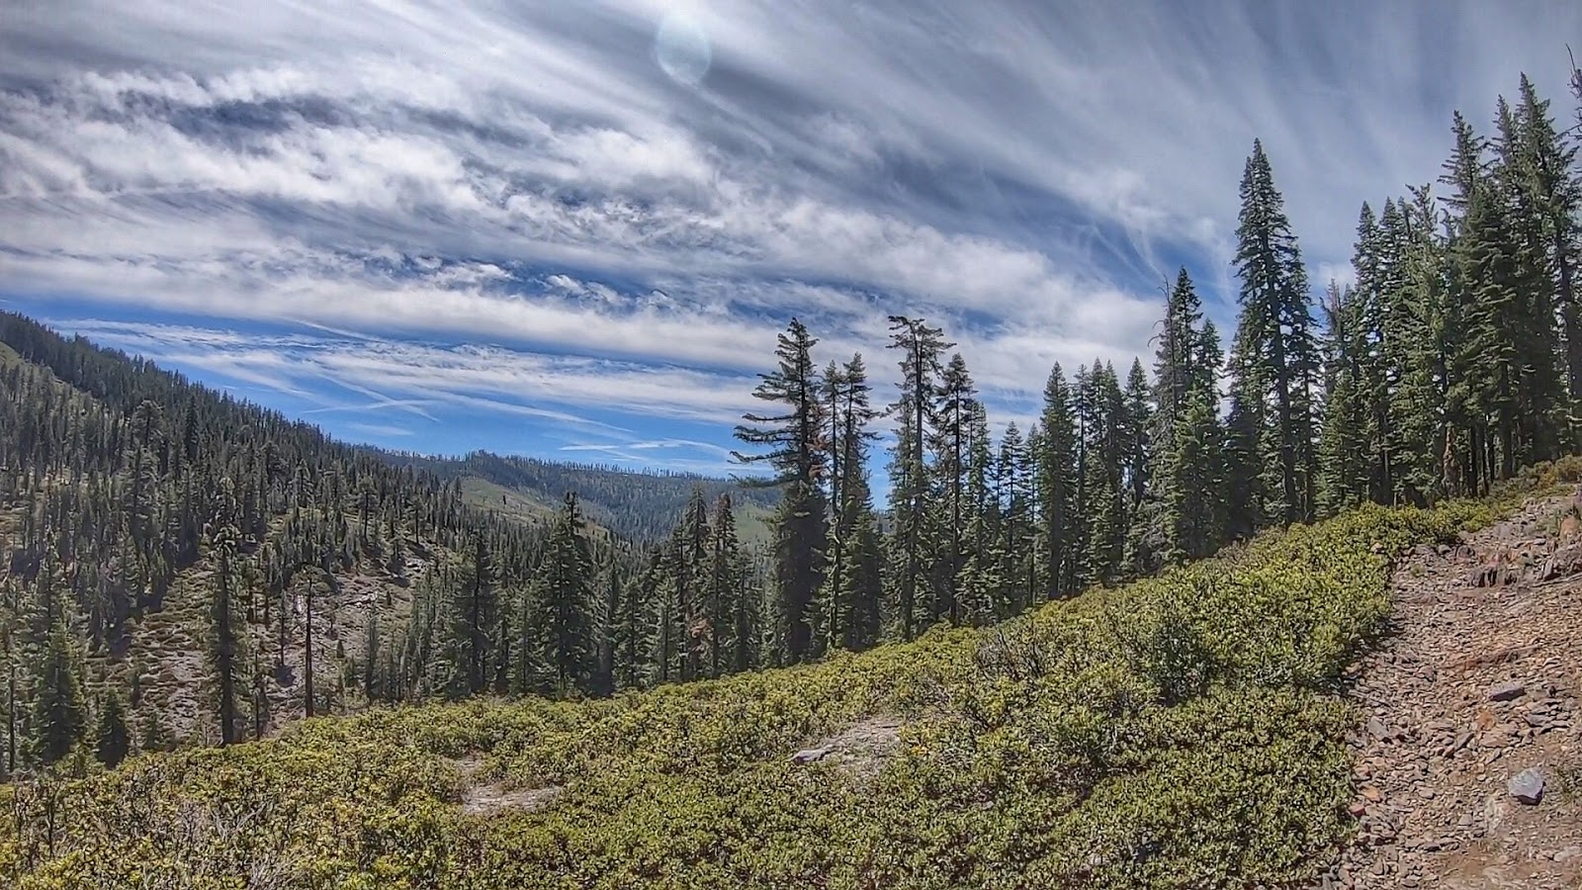
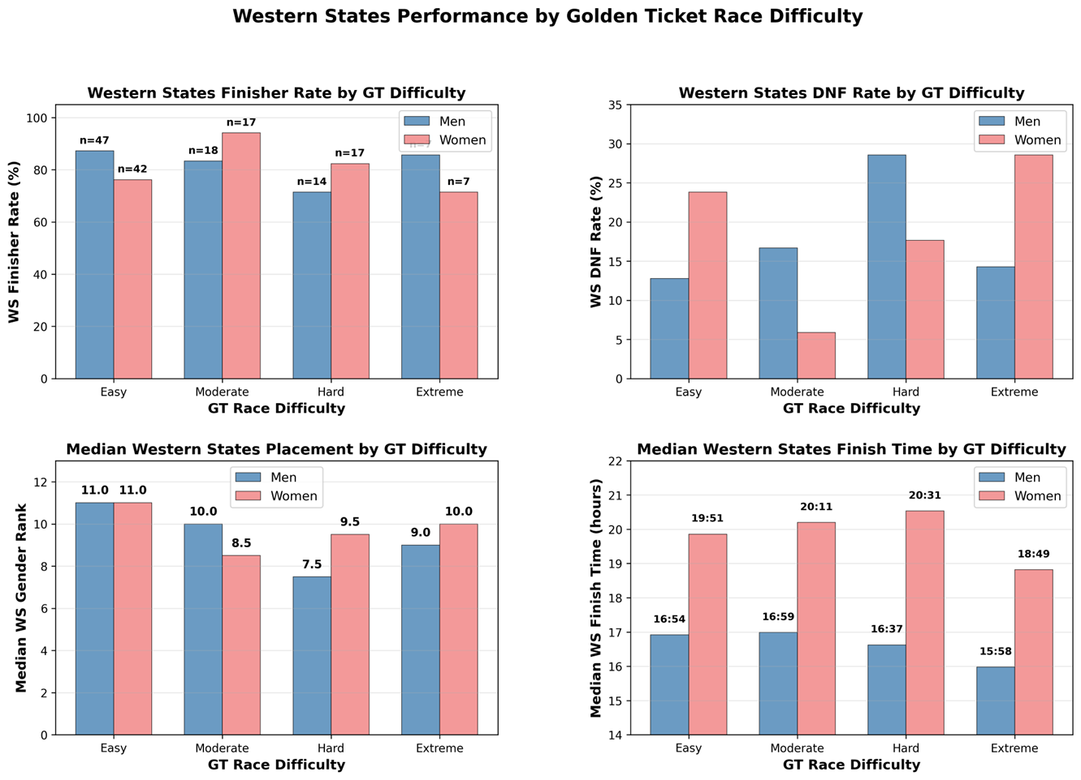
No clear performance advantage by GT race difficulty
Finisher and DNF rates vary unpredictably
Median placement remains consistent
Finish times show no systematic pattern
Key Insight:
Derived GT race difficulty (distance, elevation gain/loss, altitude exposure) does not predict Western States success. Performances are similar across all levels.
Notes:
The Main Finding:
No single GT race difficulty level consistently produces the best Western States performers. Athletes from all difficulty categories—Easy, Moderate, Hard, and Extreme—show similar outcomes at Western States.
Top Left - Finisher Rates:
Finisher rates vary unpredictably across difficulty levels. Women from Moderate races have a 94% finish rate, but women from Easy races only finish 76% of the time. Men are more consistent (71-87%) across all categories. There's no clear pattern suggesting harder or easier GT races better prepare athletes for WS.
Top Right - DNF Rates:
DNF rates also show no systematic pattern. Women from Moderate races have remarkably low DNF rates (6%), while women from Easy races DNF at 24%. Men from Hard races show elevated DNFs (29%). The variation appears random rather than linked to GT difficulty.
Bottom Left - Median Placement:
All groups finish around 7th-11th place regardless of GT difficulty. Men from Hard races place slightly better (7.5) than those from Easy races (11.0), but the differences are modest. Women show even more consistency (8.5-11.0). GT race difficulty doesn't strongly predict where you'll finish at Western States.
Bottom Right - Median Finish Times:
Finish times vary, but not in a predictable way by difficulty. Men from Extreme races are fastest (15:58), but men from Moderate races are nearly as fast (16:59). Women's times range from 18:49-20:31 with no clear pattern.
Key Takeaway:
Your Golden Ticket race choice doesn't determine your Western States success. Athletes from all difficulty levels perform similarly, suggesting that other factors—training, race-day conditions, pacing strategy, and individual preparation—matter far more than which qualifying race you ran.

Slide 8
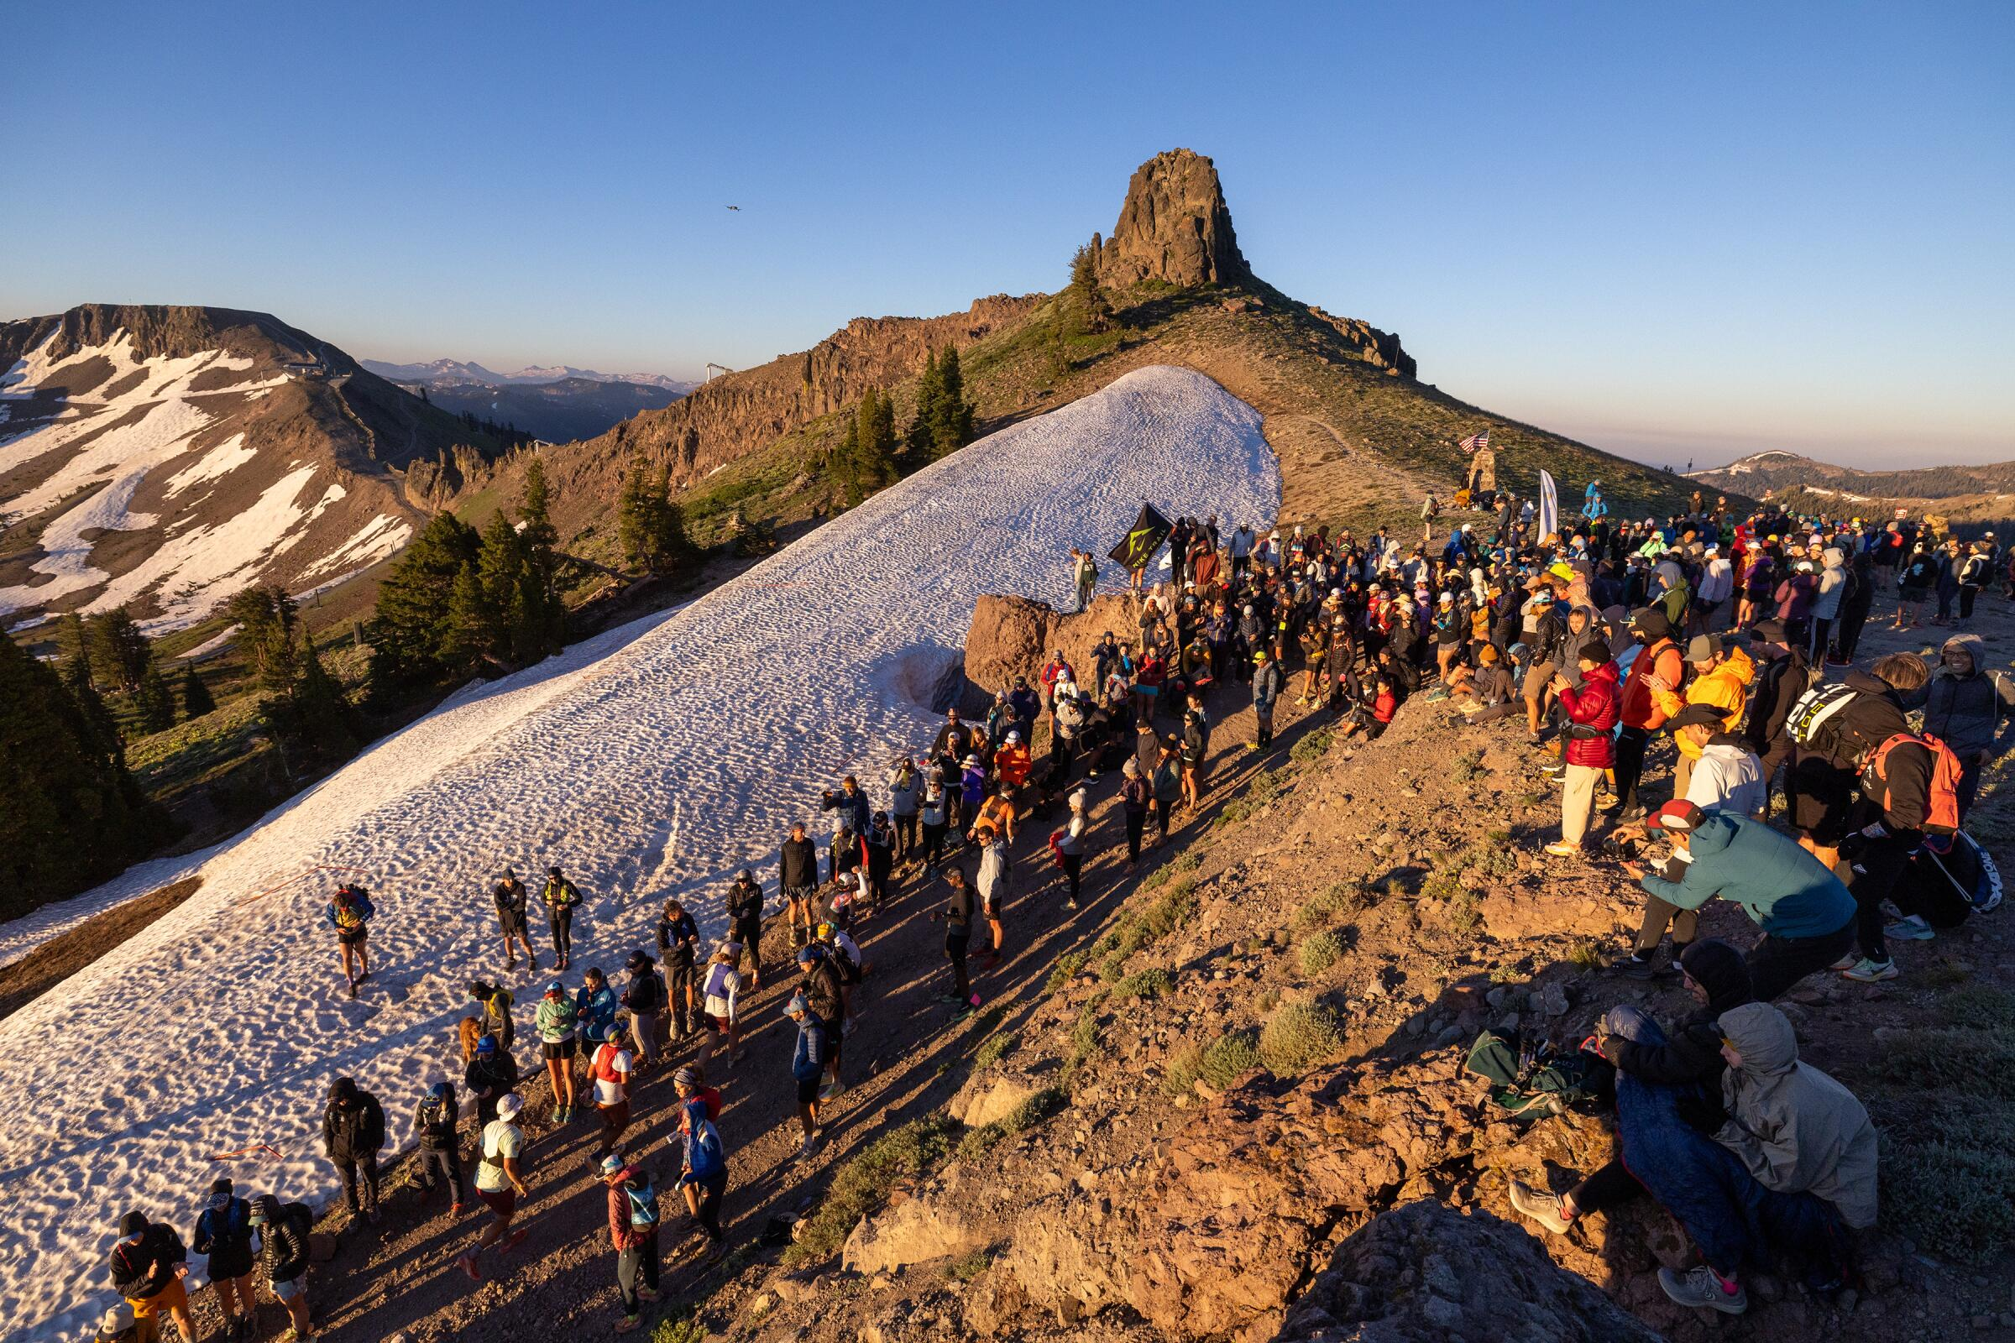
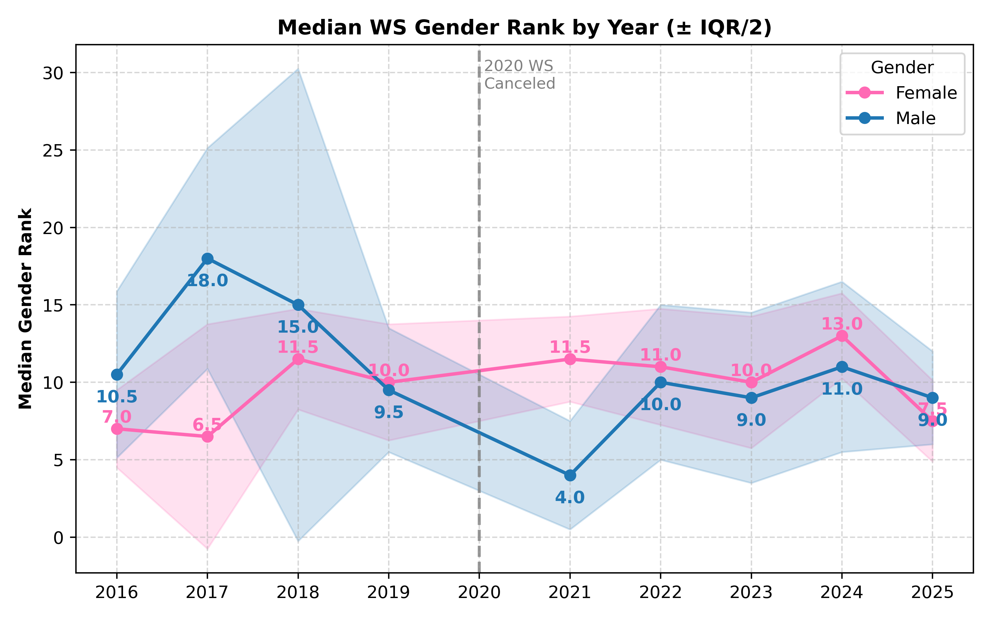
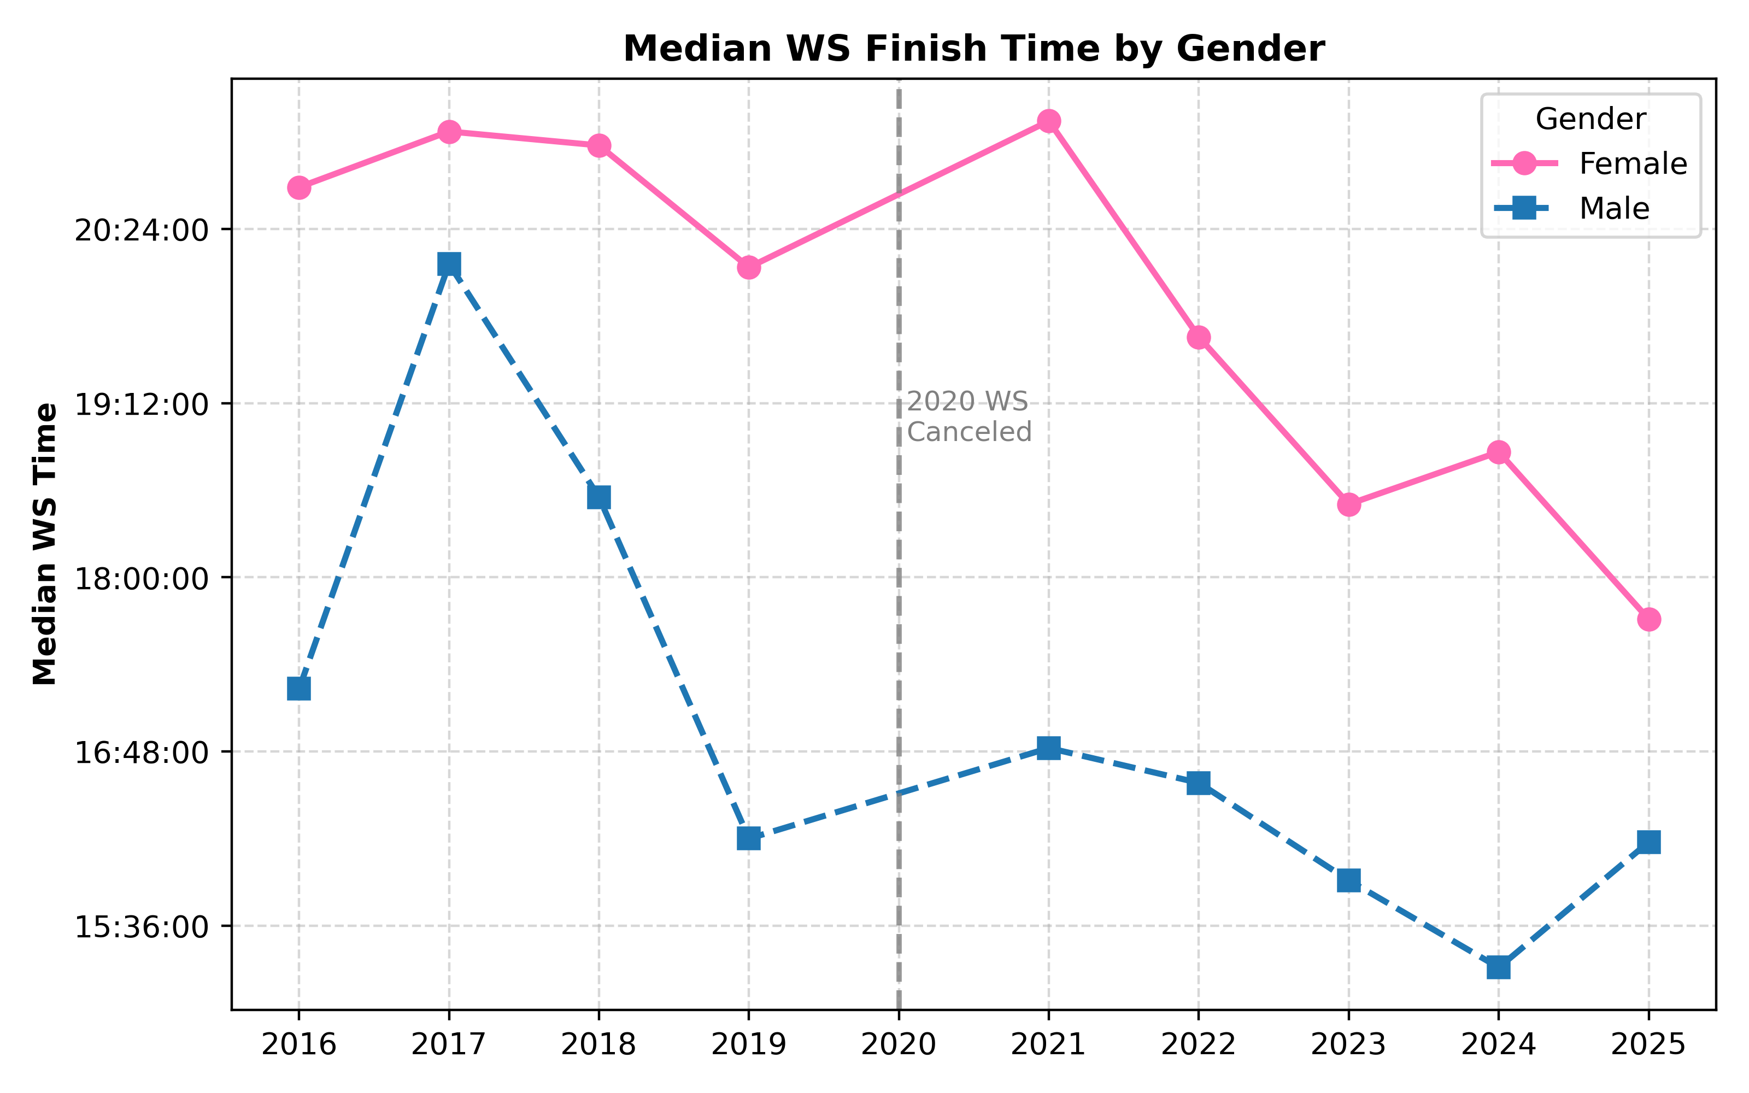
Performance Trends by Year
Median WS Gender Rank
Male: overall improved consistency especially 2022-2025 with reliably strong finishes around top-10
Female: remain consistent, hovering around top-10.
Median WS Finish Time
Male: general range 16:30h - 18:00h
Downward trend after 2021, dropping below 15:30h
Female: prior to 2022, range of 20:20h – 20:45h
Marked downward trend after 2021, dropping under 18h in 2025
Notes:
This slide highlights how Golden Ticket athletes perform at Western States over time, broken down by gender.
For median gender rank, males show improved consistency in recent years, especially from 2022–2025, reliably finishing around the top 10. Females stay steady across all years, consistently clustered near the top-10 threshold.
For median finish time, male athletes typically fall between 16.5 and 18 hours, with a clear drop toward faster times after 2021.
Female athletes show a notable shift: times range around 20–20.5 hours prior to 2022, followed by a sharp downward trend, culminating in a sub-18-hour median in 2025.
Overall, both genders show tightening performance variability and stronger depth in recent years.

Slide 9
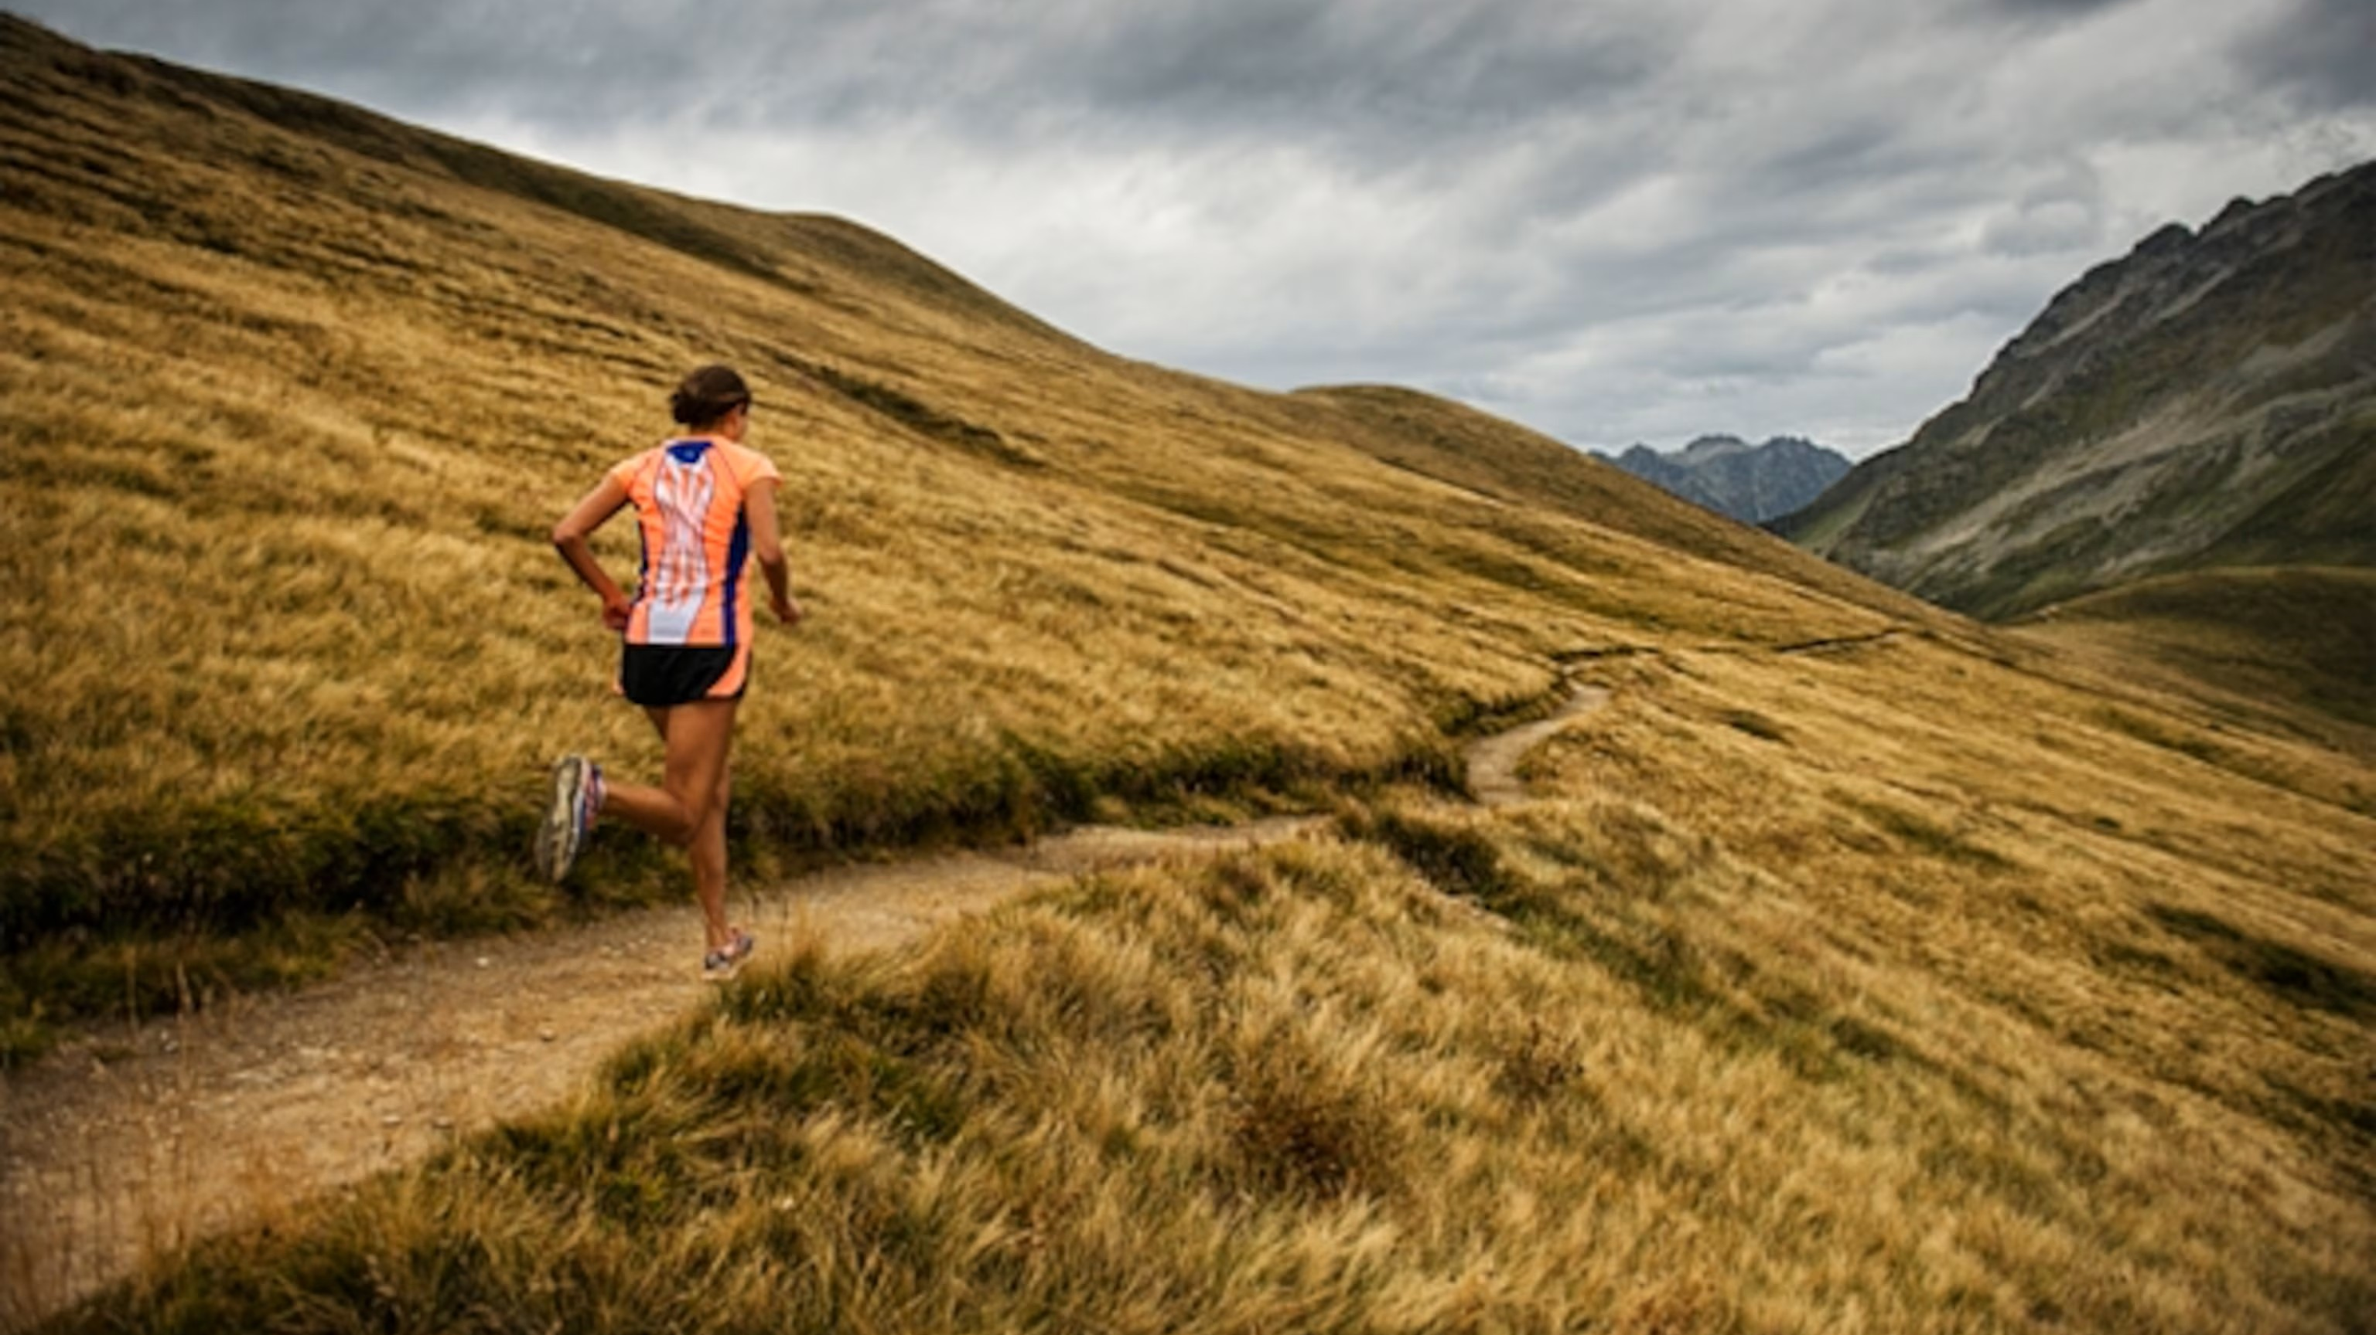
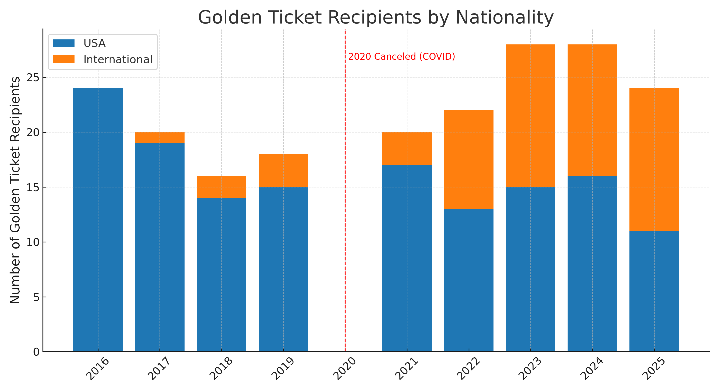
TRENDS: Domestic vs. International Athletes
Notable increase in international athletes with the introduction of international races to the GT circuit.
Finisher Rate: USA 82% vs International 84%
M - WS Median Time: Intl 16:22 * US 16:59
F - WS Median Time: Intl 19:36 * US 19:51
2022-2025
International Top-10 WS Finishers: 15
From International GT Races: 67%
Most Top-10 Intl: UTMB
Notes:
On this slide, I want to highlight how the Golden Ticket field has evolved — especially the growth of international participation — and how these athletes actually perform once they get to Western States.
From 2016 through 2021, Golden Ticket spots were almost entirely earned at U.S.-based races. Very few international athletes earned GT entries simply because more accessible pathways didn’t exist. That changed in 2022 when UTMB and Festival des Templiers were added to the Golden Ticket circuit. These races brought in a much deeper global talent pool and dramatically increased the number of international Golden Ticket recipients.
With that rise in international participation, a natural question is: Are international athletes performing differently at Western States? And more specifically, Does earning a ticket at an international GT race predict better WS performance?
What we find is that finisher and DNF rates are essentially identical between domestic and international GT athletes. Once they start the race, both groups finish at almost the same rate.
When we look deeper at actual performance — median WS finish time, mean time, and consistency — the picture becomes clearer. International men, in particular, have been performing very strongly at Western States, often running faster and with less variability than their U.S. counterparts. International women perform at the same high level whether they qualified domestically or internationally.
And importantly: There is no meaningful performance separation based on where the ticket was earned. Athletes who qualify at UTMB or Tarawera do not consistently outperform or underperform those who qualify at Bandera or Black Canyon. The GT race profile — whether easy, moderate, hard, or extreme — does not appear to determine Western States performance.
Instead, the biggest pattern we see is much simpler and much more intuitive: Top performers at Golden Ticket races are top performers at Western States. The course style they come from doesn’t predict their outcome — their talent level does.
This is especially evident in the Top 10 results since international races were added. We’ve seen a strong influx of international athletes placing in the Top 10 at Western States, and about two-thirds of those athletes earned their Golden Tickets at international races. UTMB, in particular, has produced the most Top-10 WS finishers — which makes sense given the depth of that field. UTMB attracts world-class athletes, and those athletes continue to perform at a world-class level when they come to Western States.
So the main takeaway is: The introduction of international GT races expanded the pathway for global elite athletes to enter Western States, but it didn’t change how performance relates to course type. The best athletes rise to the top regardless of where they race — and Western States performance is driven by athlete capability, not where they earned their ticket.

Slide 10
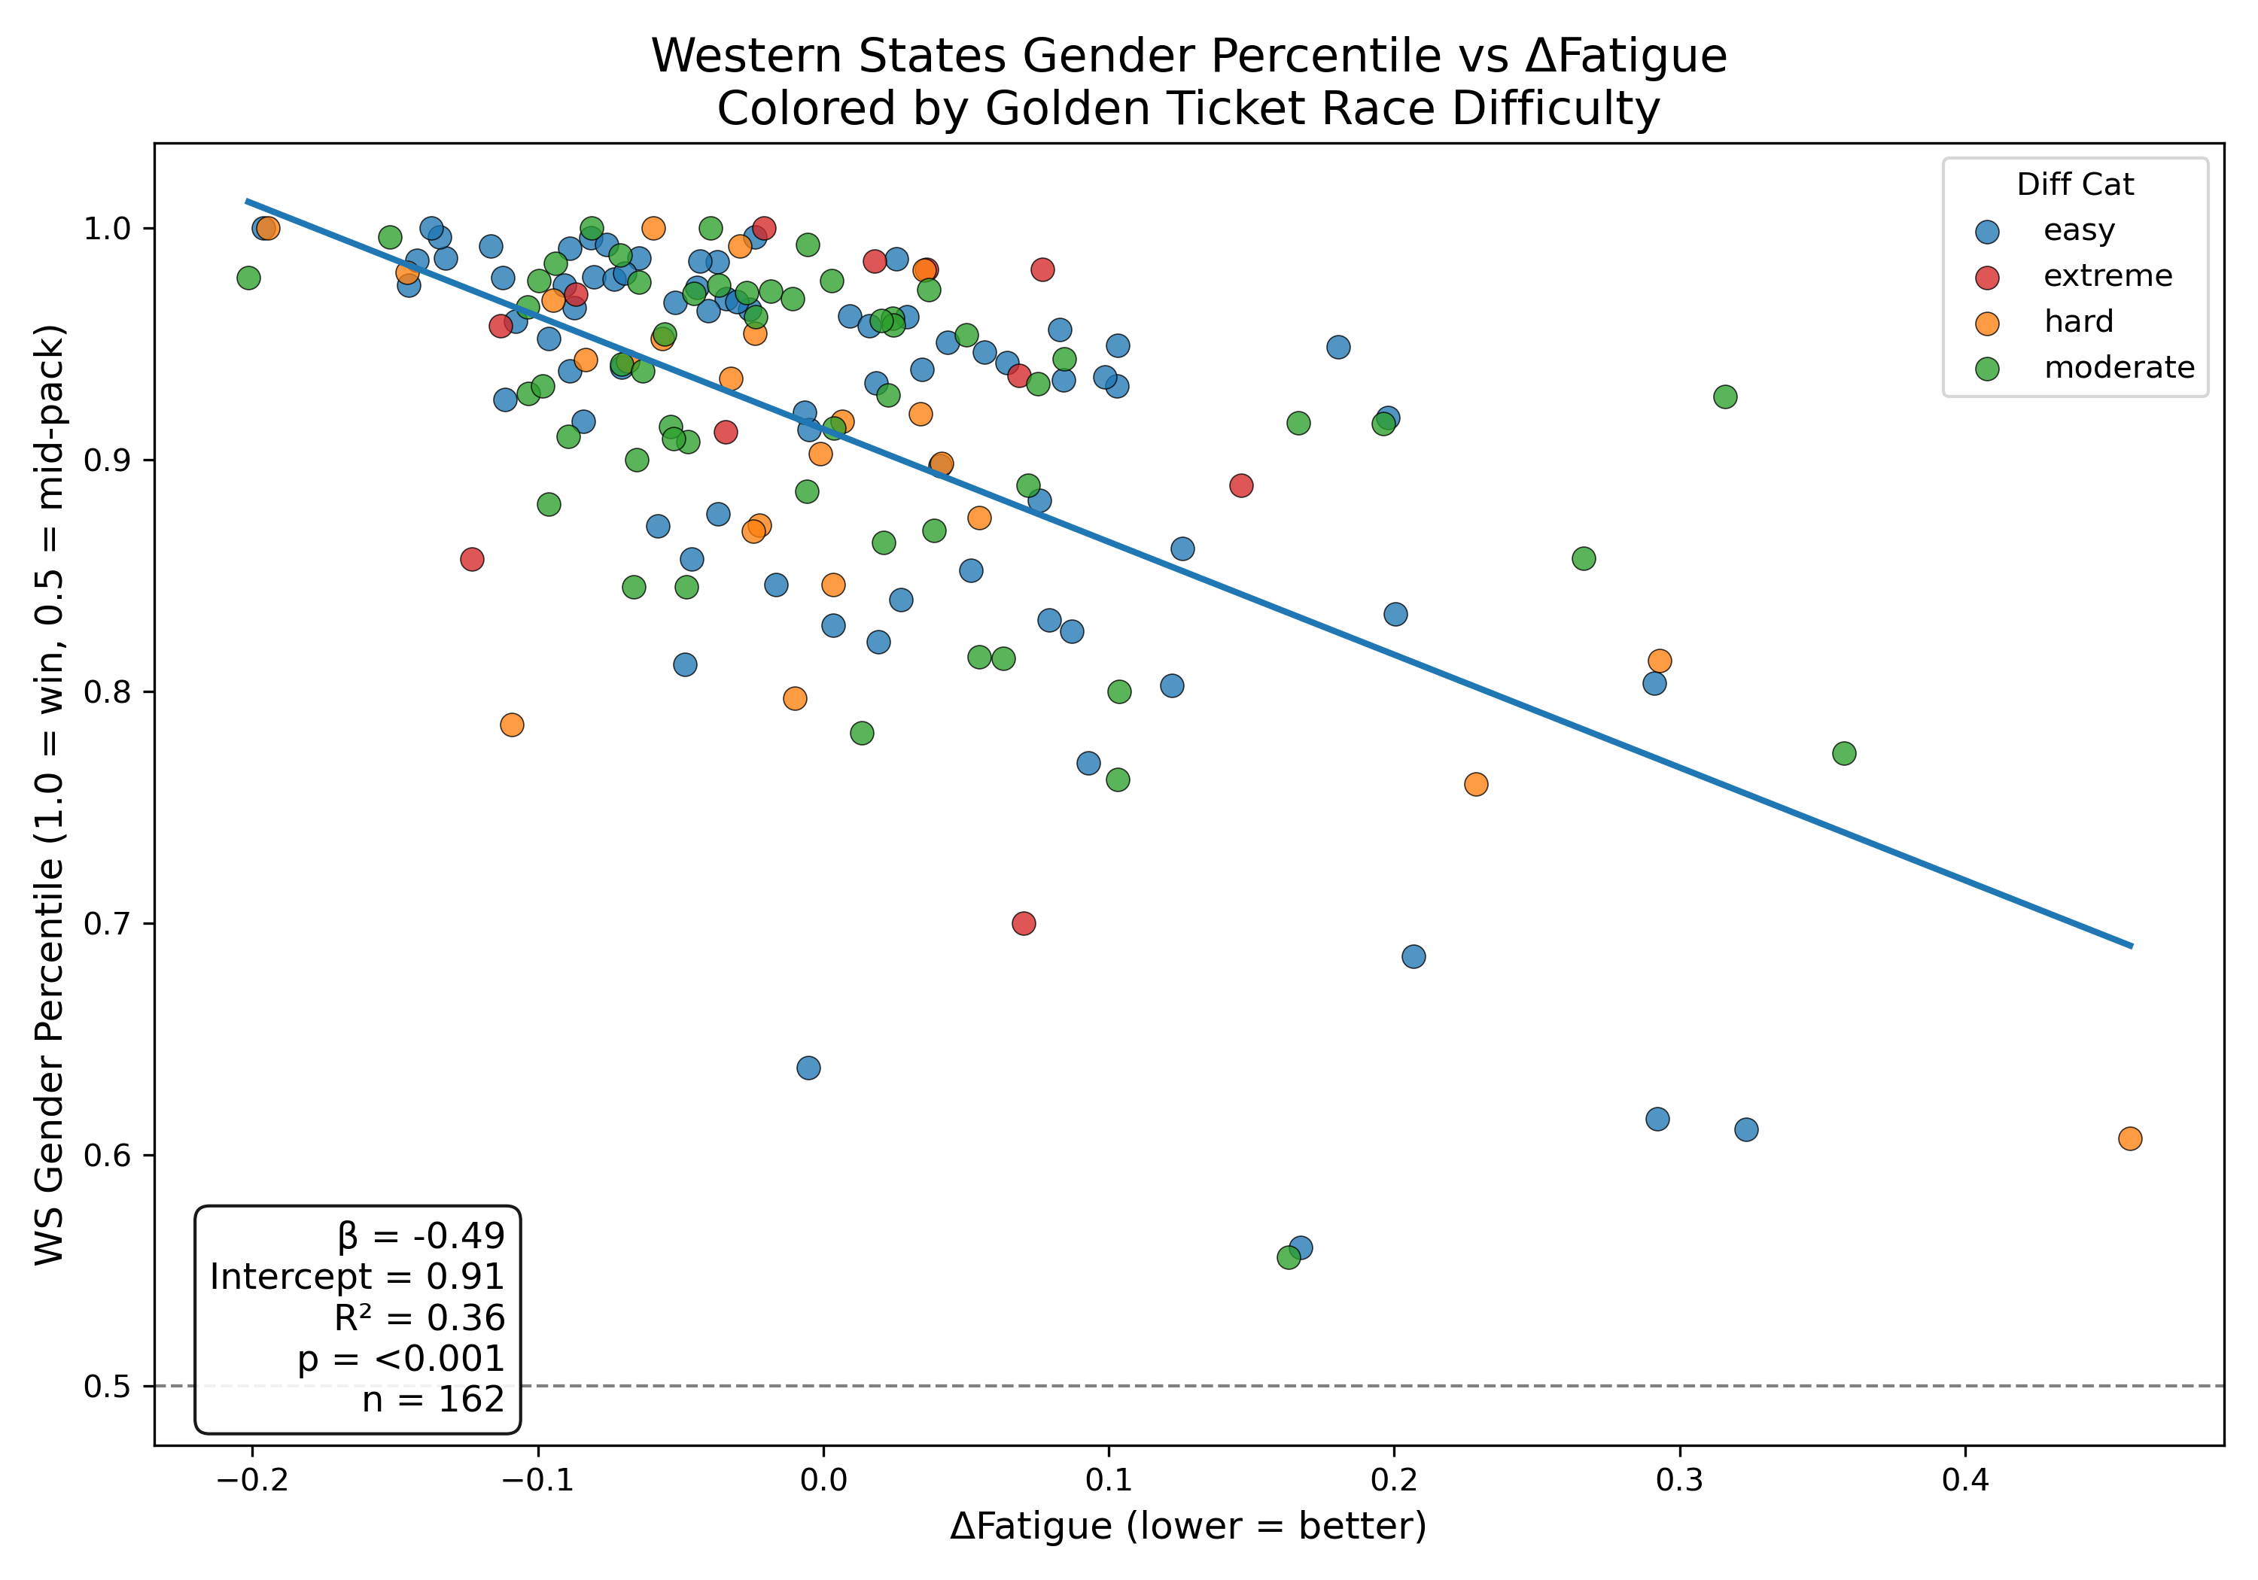
Regression Study
Figure: Relationship between style-adjusted ΔFatigue and Western States gender percentile for Golden Ticket athletes (n=162). ΔFatigue compares actual WS finish time to predicted time. Lower values mean better pacing and endurance retention. Colors represent the difficulty category of the athlete’s Golden Ticket race.
Notes:
The crux of this project is in the fact that a majority of GT races are at the 100k distance; therefore, finish times cannot be directly compared with WS finishes d/t the large difference in distance.
This figure is an exploratory look at how Golden Ticket performance translates to Western States. The x-axis shows ΔFatigue - how much an athlete slowed down at WS relative to a predicted time generated from a gender-specific Riegel model, which is widely used in the running world to extrapolate performance across varying distances.
The y-axis shows each athlete’s WS gender percentile, with colors representing the difficulty category of their qualifying race.
What we see is a meaningful exploratory signal: athletes with lower ΔFatigue — those who slowed down less than expected — tend to finish significantly higher within their gender field. The statistics: β = -0.49, meaning each 0.1 improvement in ΔFatigue translates to about 5 percentile points better placement. R² = 0.36, so this explains 36% of performance variance. This is highly statistically significant (p < 0.001)."It’s important to emphasize that this is descriptive, not predictive. Notice the colors representing GT race difficulty are scattered throughout—no clear clustering. This reinforces our earlier finding: your GT race difficulty doesn't predict success. What matters is endurance management and pacing execution on race day at Western States. Prior WS experience and days_to_ws were tested in preliminary exploratory analysis and found to have no significance (high p-values) thus were excluded.

Slide 11
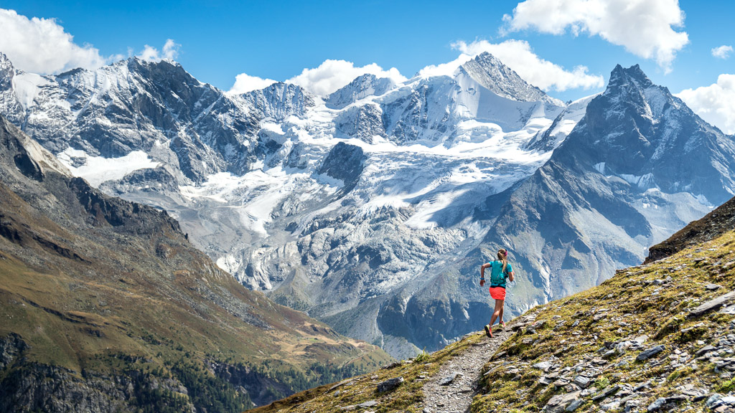
Key Takeaways
Golden Ticket race difficulty is not a strong indicator for Western States success
Elite depth and competitiveness are rising
Regression analysis (exploratory) reinforces other observations
Success at WS is influenced more by other factors than by the type of Golden Ticket race.
Median ranks and finish times are trending downward, with notable improvement in female performance in 2025.
Athletes from all GT categories perform similarly at WS; better indicators likely include training specificity, heat/altitude acclamation, and race day factors such as weather, nutrition, and pacing.
Analysis is limited by data constraints
Internationalization reshapes the field without changing performance patterns
Global GT races have expanded access, but success at WS remains driven by athlete capability, not where the ticket was earned.
Without grouping races, sample sizes are too small, leading to skewed or unreliable comparisons (especially with new races introduced in 2022). This will be a continued limitation.
Notes:
Per this study and methods used for analysis, there were no strong indicators that any specific race type predics Western States success. Across Easy, Moderate, Hard, and Extreme GT races, athletes perform very similarly at WS. This reinforces that individual athlete strength, not course difficulty, is what matters.
Next is the rise in competitiveness. Median ranks and finish times have gradually trended downward, showing a deeper and stronger GT athlete pool. The major standout is the dramatic improvement in female performance in 2025.
The exploratory regression results support what we’ve seen elsewhere: GT difficulty isn’t a meaningful predictor. Performance at WS is shaped by many other factors like training specificity, heat acclimation, weather, pacing, and nutrition.
Internationalization has changed where athletes come from, but not how they perform. Global GT races have expanded access, yet the competitive outcomes at WS remain largely the same—again suggesting athlete capability is the primary driver.
Finally, data limitations should be acknowledged. Without categorizing races into bins of similarity by difficulty, the sample size becomes too small for meaningful analysis by individual race. This is more apparent with the introduction of new international races in 2022. This limits how granular the analysis can be and is something that will continue to have an effect on future analysis.

Slide 12
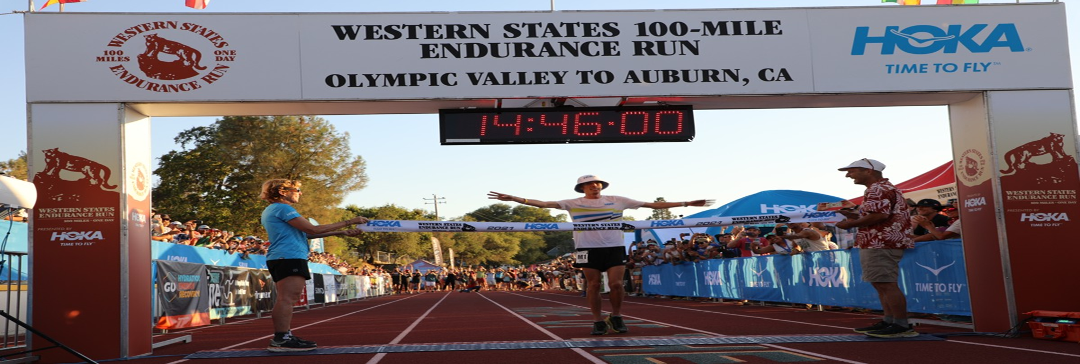
Moving Forward
1️⃣ Interactive Dashboard
An interactive dashboard may be a better approach to this dataset
Would give athletes and fans an easily accessible resource for comparing elite athletes.
Course metadata and elevation profile comparison
Historic weather conditions at specific points along racecourses
Fan engagement through fantasy league is becoming more popular
2️⃣Athlete Specific Data
Better insight could be gained by gathering athlete specific data.
Other races
Training location
Training specificity leading up to WS
Top US athletes Jim Walmsley (men’s CR holder) and Katie Schide (1st 2024, 2nd fastest time) reside and train in France
Notes:
To close out, here are two realistic next steps that could meaningfully build on this work.”
“First, an interactive dashboard.” Right now, this dataset is powerful but static. A dashboard would allow athletes, coaches, and fans to explore trends dynamically—compare elite athletes, toggle course difficulty metadata, look at elevation profiles, and even overlay historical weather for specific sections of the course. It would make this analysis far more accessible and useful long term, especially with the growing interest in fantasy leagues and performance analytics in ultrarunning.
“Second, deeper athlete-specific data.” Much of elite performance depends on factors that don’t show up in race results alone—training location/specificity, heat acclamation leading up to Western States, and additional races in a given season. Incorporating some of this context would help explain why certain athletes consistently outperform expectations. For example, athletes like Jim Walmsley and Katie Schide, who train at altitude in France, have shown how environment and preparation can influence Western States outcomes.
“Overall, even with small sample sizes, there is still meaningful opportunity to enrich and expand this project.” Instead of trying to force more data where it doesn’t exist, the next steps focus on better tools and better context, which is ultimately how we can continue improving insight into Golden Ticket athletes and Western States performance.

Slide 13
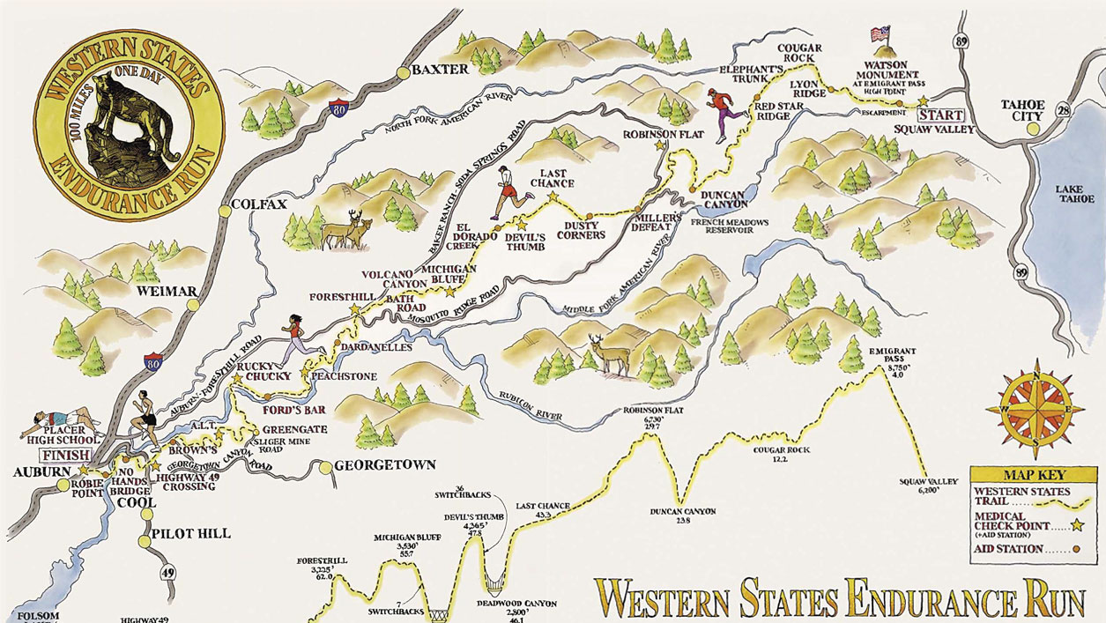
Thank you

